Slide 1

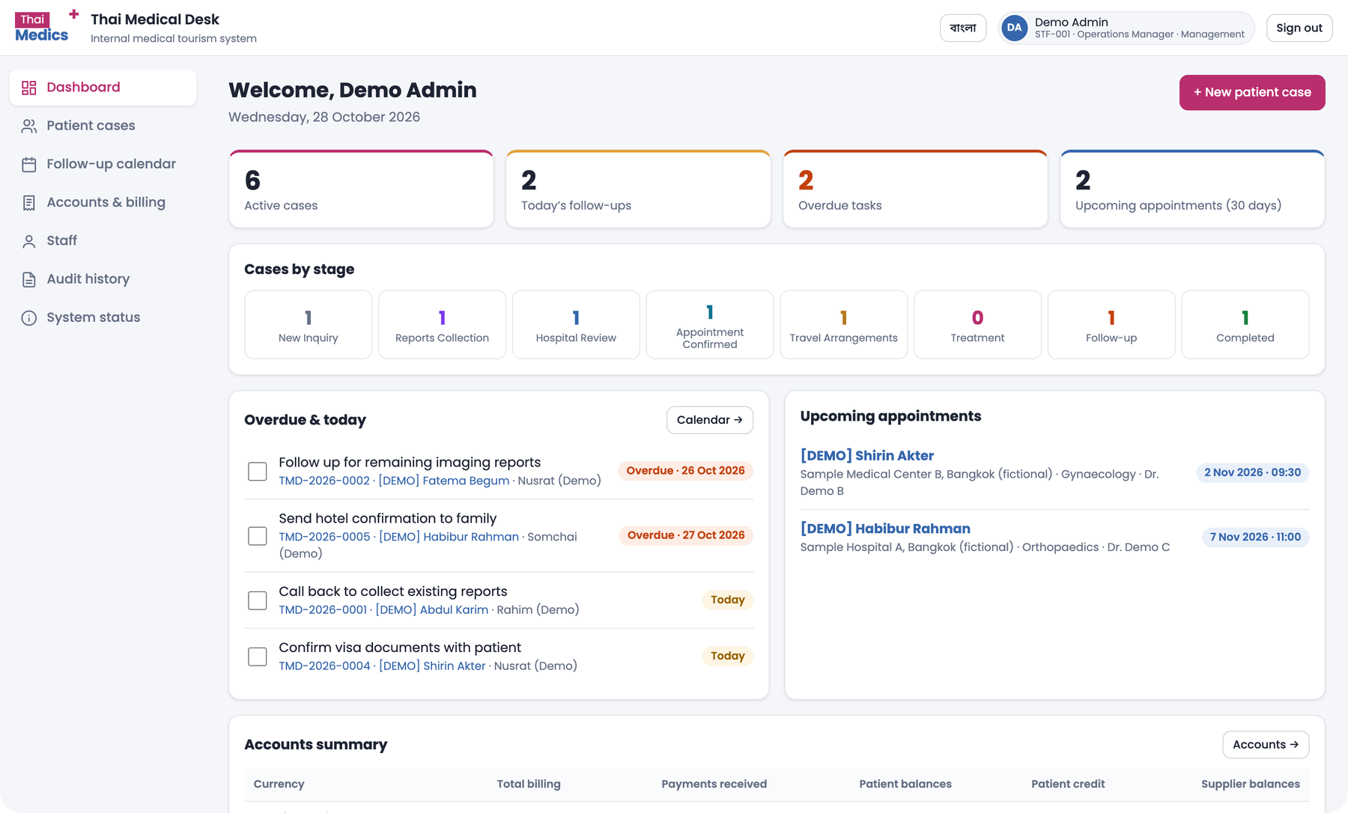
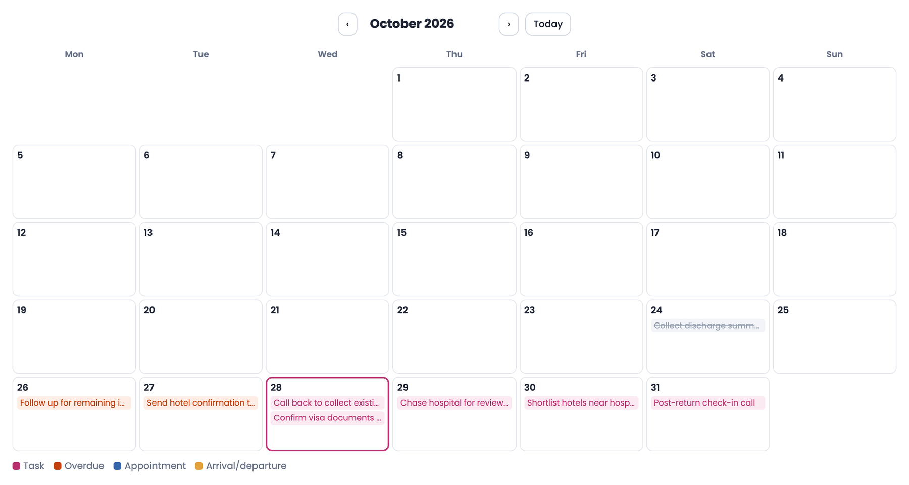
Thai Medical Desk
MEDICAL TOURISM · BANGLADESH ⇄ THAILAND
Prototype walkthrough, user flow and the modules to build next
7 modules today
8-stage journey
12 modules proposed
October 2026
Notes:
Thai Medical Desk is the internal system for Thai Medics: it takes a patient from Bangladesh from first inquiry to treatment in Thailand. Today we walk through the prototype, the user flow, and the modules we recommend adding.

Slide 2












One shared desk for every patient
OVERVIEW
WHAT IT IS
A case-management and billing desk for bringing patients from Bangladesh to hospitals in Thailand.
8
7
7
5
Case stages
Main screens
Tabs in every case
Role templates
WHO USES IT
Bangladesh office
Intake, reports, family contact
Thailand office
Hospitals, travel, on the ground
Accounts
13
6
3
2
Quotes, invoices, payments
Management
Individual permissions
Charge types
Currencies: BDT · THB · USD
Languages: Bangla · English
Oversight, staff, audit
Notes:
The system is used by four groups: the Bangladesh office, the Thailand office, accounts and management. The numbers on the right summarise the scope of the prototype.

Slide 3
What's built today
01
The seven modules of the working prototype and what each one does
Notes:
Section one: the modules that already exist in the prototype.

Slide 4






Seven screens around one patient case file
MODULES TODAY
Dashboard
Patient cases
Follow-up calendar
Accounts & billing
Active cases, today's and overdue follow-ups, next 30 days of appointments, cases by stage
Search by name, case ID, phone or hospital; filter by stage, coordinator and office
Month and list views of tasks, appointments, arrivals and departures
Patient accounts, quotations, invoices, receipts, supplier balances and profit
Inside every case
Overview
Medical records
Communication
Hospital & appointment
Thailand assistance
Follow-up tasks
Accounts & billing
Staff
Audit history
System status
Add, approve and deactivate staff; set permissions in a matrix
Every action logged with who did it, what changed and when
A summary of what the prototype covers, plus a demo-data reset
Notes:
Seven screens in the left menu. Everything revolves around the patient case, which opens into seven tabs, shown in the pink card.

Slide 5
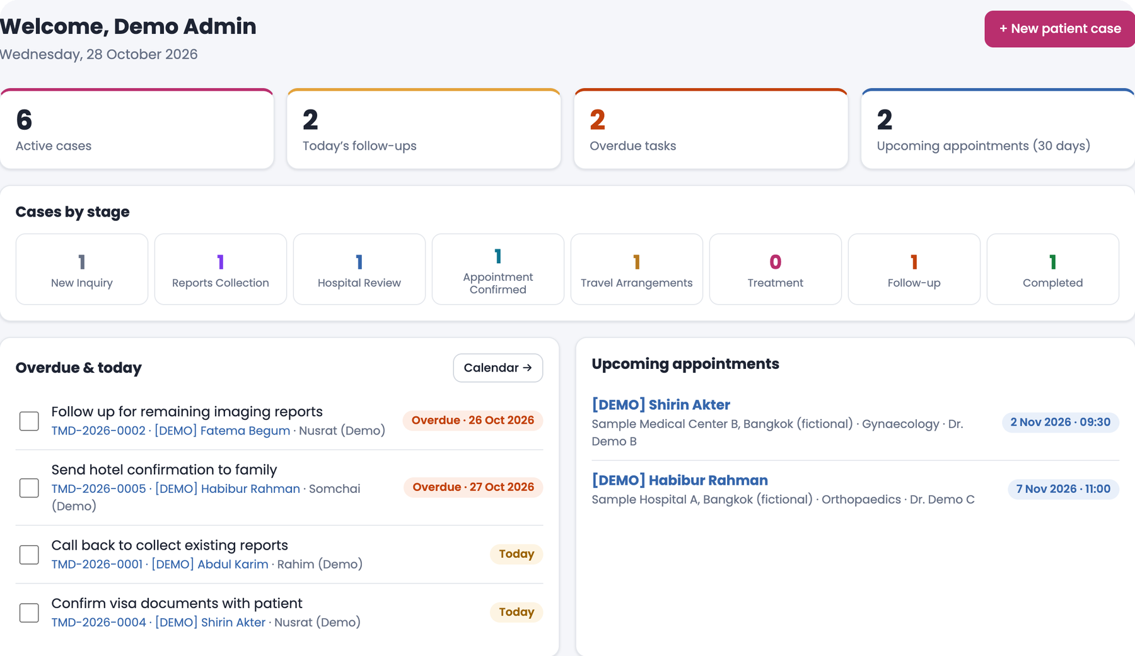

What's due today, and any case in seconds
MODULE · DASHBOARD & PATIENT CASES
Dashboard
Live counters: active cases, today's follow-ups, overdue tasks, appointments
Stage strip jumps to a filtered case list
Tick off tasks; accounts summary per currency
Patient cases
Search by name, case ID, phone or hospital
Filter by stage, coordinator and office
New cases get an automatic ID, e.g. TMD-2026-0008
Dashboard opens on today's priorities
Notes:
The dashboard is the coordinator's start page: overdue and today's tasks first. Patient cases is the searchable list of every case.

Slide 6
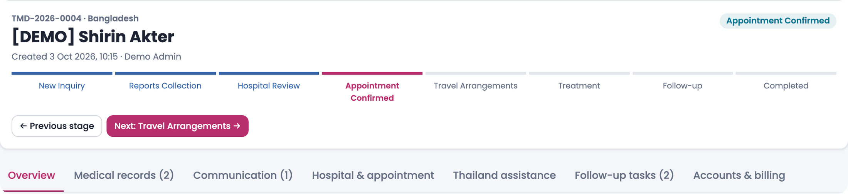







One case: a stage tracker and seven tabs
MODULE · PATIENT CASE FILE
Overview
Medical records
Communication
Hospital & appointment
Thailand assistance
Follow-up tasks
Accounts & billing
Patient, companion and the BD and TH coordinators
Reports by date with uploader recorded
Call, WhatsApp and email notes; next action becomes a task
Doctor, dates, proposal and days awaiting reply
Flights, stay, transfers, interpreter, handover notes
Owner and due date; overdue highlighted
The patient's bill, payments and documents
Notes:
Each case shows where it sits in the eight stages, with buttons to move forward or back. The seven tabs hold everything about the patient.

Slide 7




Tasks, appointments and travel in one view
MODULE · FOLLOW-UP CALENDAR
Month view
Colour-coded tasks, appointments, arrivals and departures
Task list
Overdue, today, next 14 days and recently completed
Automatic tasks
A note with a next-action date becomes a task
Task
Overdue
Appointment
Arrival / departure
Mine only
Each coordinator can filter to their own work
Notes:
The calendar brings tasks, hospital appointments and flights together so nothing is missed.

Slide 8






Full patient billing, tied to the case ID
MODULE · ACCOUNTS & BILLING
Six charge types
BDT · THB · USD with recorded rate
From quote to receipt
Visa fees
Air ticket
Hotel
1
Draft charges
Editable until the invoice is issued
travellers × fee + service
charge + service fee
rooms × nights × rate
Quotation
2
An estimate the patient can see any time
Land package
Service charges
Discounts
3
Issue invoice
Charges numbered INV-year-no. and locked
quantity × unit rate
agreed amount
subtracted from bill
4
Payments & refunds
Cash, bank, bKash/Nagad, card or cheque, with receipts
Example · case TMD-2026-0004 (USD)
5
Reverse to correct
An equal and opposite entry with a reason
1,506.60
549.00
957.60
585.20
6
Print or PDF
Total bill
Paid
Balance due
Est. profit
Quotation, invoice, receipt and statement
Notes:
Every money entry is tied to the case ID. Six charge types with built-in calculations, a clear quote-to-receipt flow, and nothing is ever deleted: corrections are reversals.

Slide 9
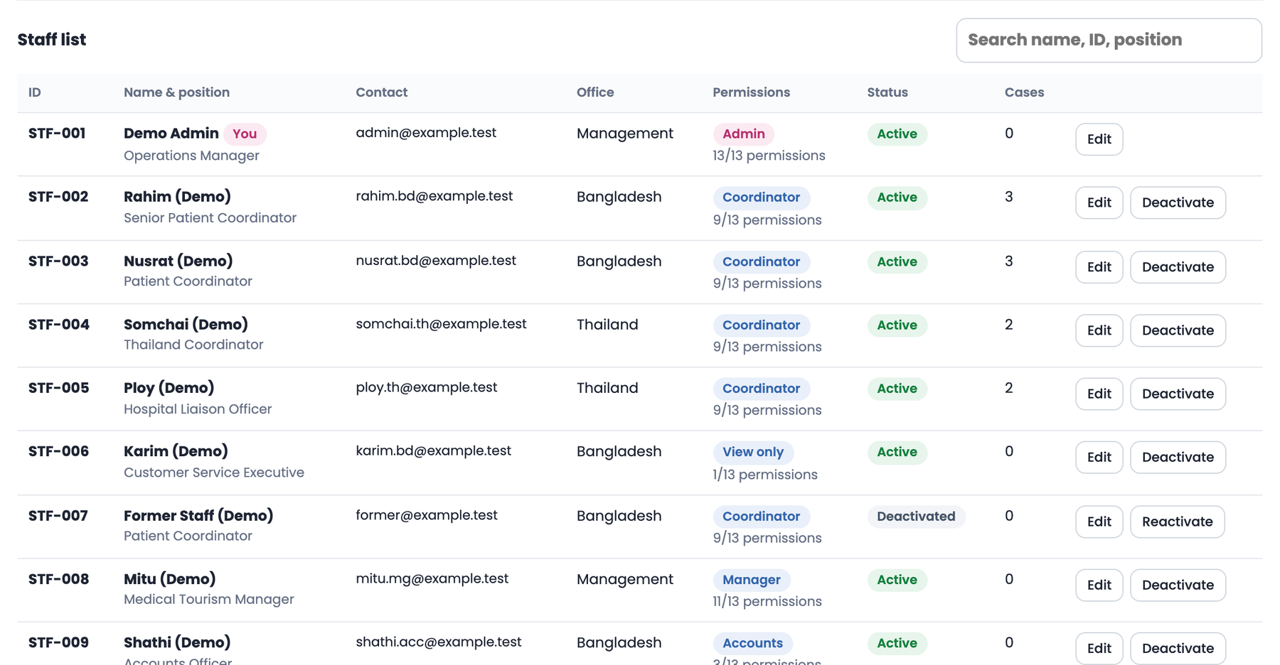


Five role templates built from 13 permissions
MODULE · STAFF, ROLES & AUDIT
Permission area | Admin | Manager | Accounts | Coord. | View
Create & edit cases | ● | ● | – | ● | –
Change case stage | ● | ● | – | ● | –
View & download records | ● | ● | ● | ● | ●
Upload records, notes, tasks | ● | ● | – | ● | –
Hospital & Thailand details | ● | ● | – | ● | –
View accounts | ● | ● | ● | – | –
Post charges & invoices | ● | – | ● | – | –
Manage staff & permissions | ● | – | – | – | –
View audit history | ● | ● | – | – | –
Three offices
Bangladesh, Thailand and Management
Audit history
Who did what, to which record, and when
Bangla & English
Switch language any time, desktop or mobile
Change any single tick and the role becomes “Custom”. Staff belong to one office.
Notes:
Access is built from 13 permissions. Roles are templates: Admin, Manager, Accounts, Coordinator and View only. Every change is written to the audit history.

Slide 10
How work flows
02
The patient journey through eight stages, and a coordinator's working day
Notes:
Section two: how a case moves through the system and how each team works on it.

Slide 11
Eight stages, from inquiry to completed case
USER FLOW · PATIENT JOURNEY
01
02
03
04
05
06
07
08
New Inquiry
Reports Collection
Hospital Review
Appointment Confirmed
Travel Arrangements
Treatment
Follow-up
Completed
Patient or family contacts the Bangladesh office
Existing medical reports collected and uploaded
Reports sent to a Thai hospital; reply tracked
Doctor, date and proposal agreed; billing opens
Visa, flights, hotel, transfers and interpreter
Patient treated; Thailand office on the ground
Check-ins and reports after treatment
Case closed and account settled
Who works on the case
Bangladesh team — owns the case and the patient relationship
Thailand office — hospitals, travel and on-ground support
Accounts — quotation, invoice and payments
Notes:
A case moves forward one stage at a time. The Bangladesh team owns it end to end; the Thailand office joins at hospital review; accounts starts billing once the appointment is confirmed.

Slide 12







A coordinator's day runs in a simple loop
USER FLOW · DAILY LOOP
STEP 1
STEP 2
STEP 3
STEP 4
STEP 5
Sign in
Open a case
Update a tab
Set next action
Move the stage
Dashboard opens on overdue and today's tasks
From a task, a stage counter or search
Upload a report, log a call, edit hospital or travel
A due date turns into a task on the calendar
Advance once the stage's work is done
Handover between offices
A permanent contact log
Bangladesh and Thailand coordinators share handover notes on each case; notes from the other office are flagged.
Every call and message stays on record with its outcome and next action; notes cannot be edited or deleted.
Notes:
This loop repeats for each case. Handover notes keep the Dhaka and Bangkok teams in sync.

Slide 13
Four teams, one case, clear hand-offs
USER FLOW · WHO DOES WHAT
Stages 1–8
Stages 3–7
Stages 4–8
All stages
Bangladesh coordinator
Thailand coordinator
Accounts officer
Manager & admin
Opens the case and records the stated need
Collects and uploads reports
Logs every call and WhatsApp
Keeps the family updated
Sends reports to hospitals and chases replies
Confirms doctor and appointment
Books stay, transfers and interpreter
Writes handover notes
Adds visa, ticket, hotel and package charges
Issues quotation and invoice
Records payments and refunds
Tracks supplier costs
Watches the dashboard and stage counts
Reviews accounts and profit
Manages staff and permissions
Checks the audit history
MAIN SCREENS
MAIN SCREENS
MAIN SCREENS
MAIN SCREENS
Overview · Records · Communication
Hospital · Thailand assistance · Tasks
Accounts & billing · Statements
Dashboard · Staff · Audit history
Notes:
Each team has a clear slice of the journey; permissions match these responsibilities.

Slide 14
What to build next
03
Recommended modules to turn the desk into a complete medical-visa operation
Notes:
Section three: the modules we recommend adding, why, and in what order.

Slide 15








Where work still happens outside the system
WHY ADD MORE
Hospitals typed by hand in each case
Doctors aren't tracked
No price lists, comparison or partner contacts
Hard to match a patient to the right specialist
No visa tracking
No agent records
Missing documents surface late and delay travel
Can't see who referred a patient or pay commission fairly
Inquiries arrive scattered
Patients can't see their status
Facebook, website and phone leads slip away
Repeated calls and WhatsApp messages to staff
No templates or reminders
No business reports
Replies are slow and inconsistent
No view of conversion or profit by hospital or agent
Notes:
These are the everyday gaps where staff still rely on WhatsApp, spreadsheets and memory. Each maps to a proposed module.

Slide 16












Twelve new modules across four pillars
RECOMMENDED MODULES
Partner network
Patient journey
Service delivery
Care & growth
The people we work with
From first inquiry to visa
Packages, suppliers, ground
Retain, learn, grow
Hospital directory
Lead & inquiry hub
Packages & quote compare
Aftercare & feedback
Partner hospitals, departments, packages, contacts
Every inquiry captured, sourced and followed
Send once, compare hospital quotes
Post-return check-ins, reviews, ratings
Doctor management
Medical visa desk
Supplier & vendor hub
Messaging & reminders
Specialists, schedules, languages, outcomes
Checklists, embassy status, reminders
Hotels, airlines, transport, interpreters
Bangla/English WhatsApp and email templates
Agent network
Patient & family portal
Thailand ground services
Reports & analytics
Referrals, commissions, agent self-view
Status, uploads and invoices on the phone
Pickups, interpreters, daily schedule
Conversion, revenue and profit by source
Notes:
Twelve modules grouped into four pillars. The next slides go through each pillar in detail.

Slide 17

Hospital directory and doctor management
SPOTLIGHT · PARTNER NETWORK
Hospital directory
SEND ONCE, COMPARE REPLIES
One click shares a case with several hospitals; replies line up side by side
Partner hospitals with departments, accreditation and location
Package price lists with validity dates
International-desk contacts and reply-time history
Pick a hospital from the list instead of typing it
Case reports + need
Hospital A
Hospital B
Hospital C
Hospital | Package estimate | Reply in | Doctor
Hospital A | THB 180,000 | 2 days | Orthopaedics
Hospital B | THB 165,000 | 1 day | Orthopaedics
Hospital C | THB 210,000 | 4 days | Sports med.
Doctor management
Profiles: specialty, hospital, languages, clinic days
Match a case's stated need to the right specialist
See which doctor treated which patient, and outcomes
Request second opinions from several doctors
Illustrative example
Outcome: the chosen reply becomes the patient's proposal and quotation, with no retyping.
Notes:
Hospitals and doctors become structured lists rather than free text. That unlocks sending a case to several hospitals and comparing their replies.

Slide 18






Agent network with automatic commission
SPOTLIGHT · PARTNER NETWORK
Agent refers a patient
Case tagged to agent
Case reaches billing
Commission calculated
Payout & statement
From a district agent or partner clinic
Source saved on the case from day one
Commission is triggered by the stage reached
% or fixed, by agent, hospital or package
Monthly statement, paid and pending
What the office gets
What the agent sees
Agent profiles with district, contact and agreed terms
Referral source on every case, alongside Facebook, website or walk-in
Commission rules per agent, hospital or package
Ranking of agents by referrals, conversions and revenue
Only their own referrals and each one's current stage
Commission earned, pending and paid
Send a new patient lead from the phone
Download a monthly statement
Notes:
Agents are a major source of patients. Recording who referred each patient lets commission be calculated automatically and gives agents a self-view of their referrals.

Slide 19

Every lead captured, every visa cleared
PILLAR · PATIENT JOURNEY
Lead & inquiry hub
Medical visa desk
Patient & family portal
No inquiry goes unanswered
Clear the visa before the flight
Status without a phone call
Website, Facebook and phone inquiries open a case automatically
Source recorded: agent, Facebook, website, walk-in
Duplicate warning by phone or passport
“Lost lead” status with a reason
Response time tracked per coordinator
Document checklist for patient and each attendant
Hospital appointment and invitation letters tracked
Embassy submission and visa status
Alerts on passport expiry and appointment date
Attendant visas handled with the patient's
Simple phone access for patient and family
Current stage, appointment and visa status
Upload reports and passport copies
Invoices and receipts, payments recorded manually by accounts
Works in Bangla and English
Solves: leads lost between channels
Solves: late surprises before travel
Solves: repeated status calls
Notes:
Pillar two covers the patient's side of the journey: every lead captured, visas managed with checklists, and a portal so families can see progress themselves.

Slide 20



Packages, suppliers and ground care together
PILLAR · SERVICE DELIVERY
Treatment package catalogue: check-ups, orthopaedics, cardiac, IVF
Send reports to several hospitals at once
Packages & quote comparison
Faster, comparable proposals
Compare quotes side by side
Turn the chosen quote into the patient quotation
Hotels, serviced apartments, airlines, transport, interpreters
Negotiated rates and contract validity
Supplier & vendor hub
Every partner rate on file
Supplier bookings linked to cases
Supplier payments and balances together
Airport pickup and hospital transfer roster
Bengali–Thai interpreter scheduling
Thailand ground services
A smooth stay in Bangkok
Day-by-day schedule for each patient
Emergency contact and on-call staff
Notes:
Pillar three makes delivery consistent: packages and quote comparison, a single place for supplier rates, and structured on-the-ground services in Thailand.

Slide 21





Stay close after treatment, see what works
PILLAR · CARE & GROWTH
Your appointment is on 2 Nov
“Smooth from Dhaka to discharge”
Thanks, see you there!
Aftercare & feedback
Messaging & reminders
Reports & analytics
Check-ins at 1 week, 1 month and 3 months after return
Follow-up video consults with the Thai doctor
Medication and next-visit reminders
Ratings and reviews per hospital and staff member
Ready templates in Bangla and English
WhatsApp and email sent from the case and saved to it
Automatic reminders: documents, payment, flight, appointment
Broadcasts for health camps and offers
Monthly inquiries, conversion and lost-lead reasons
Revenue and profit by hospital, agent and package
Coordinator workload and response time
Export any list or report to Excel
Notes:
Pillar four keeps the relationship going after treatment and gives management the numbers: conversion, revenue and profit by hospital, agent and package.

Slide 22


The journey after the upgrade
USER FLOW · AFTER THE UPGRADE
NEW STAGE
01
02
03
04
05
06
07
08
09
New Inquiry
Reports
Hospital Review
Appointment
Visa
Travel
Treatment
Follow-up
Completed
Lead hub
Patient portal
Hospitals
Packages
Visa desk
Supplier hub
Ground services
Aftercare
Analytics
Agent network
Doctors
Messaging
Commission
Quote compare
Lost lead, from any stage
Source tagged at intake
Close a case as lost with a reason: price, another provider, medical advice, visa refused. Reasons feed the reports.
Every case records where it came from: agent, Facebook, website, walk-in or referral, so commission and marketing ROI are automatic.
Notes:
The eight stages stay, with one new Visa stage between appointment and travel. Each new module attaches to the stage where it is used.

Slide 23






Quick wins inside today's modules
IMPROVE WHAT EXISTS
01
02
03
Visa stage
Lost-lead status
Patient source
A dedicated stage between appointment and travel
Close a case as lost, with a reason to learn from
Agent, Facebook, website or walk-in on every case
04
05
06
Duplicate warning
Lock supplier costs
Export to Excel
Flag returning patients by phone or passport
Costs lock once paid, so past profit can't change silently
Any list or report, in one click
Notes:
Small changes to existing screens that deliver value immediately, before the larger modules.

Slide 24







Everything connects around one shared case
TARGET PICTURE
OUTSIDE PARTIES
INTERNAL TEAMS
Thai Medical Desk
Patients & families
one case file · one calendar · one account
Bangladesh office
Partner network
Patient journey
Agents
Hospital directory
Doctor management
Agent network
Lead & inquiry hub
Medical visa desk
Patient & family portal
Thailand office
Hospitals & doctors
Service delivery
Care & growth
Accounts
Embassy
Packages & quote compare
Supplier & vendor hub
Thailand ground services
Aftercare & feedback
Messaging & reminders
Reports & analytics
Management
Suppliers
Today: Dashboard · Cases · Calendar · Billing · Staff · Audit
Notes:
The target picture: outside parties feed one shared case, worked by four internal teams, with the twelve new modules around the core built today.

Slide 25



Build in three waves, partners first
SUGGESTED ORDER
1
2
3
WAVE 1
WAVE 2
WAVE 3
Partners & visas
Faster service
Experience & insight
Hospital directory
Lead & inquiry hub
Patient & family portal
Doctor management
Messaging & reminders
Thailand ground services
Agent network
Packages & quote comparison
Aftercare & feedback
Medical visa desk
Supplier & vendor hub
Reports & analytics
Quick wins on today's screens
Biggest daily pain; every later module builds on this partner data
Faster replies and quotes, with nothing lost between channels
Uses the data gathered in waves 1–2 to serve patients and guide decisions
Notes:
A suggested order. Wave 1 adds the partner data, hospitals, doctors and agents, plus the visa desk. Waves 2 and 3 build on it.

Slide 26
NEXT STEPS
Let's finalise the module list
01
02
03
Walk the prototype with both offices
Agree the 12 modules and their order
Design the Wave 1 screens
Confirm the 8 stages, fields and roles match daily work in Dhaka and Bangkok
Mark each one must-have, next or later
Hospitals, doctors, agents and the visa desk, built on today's look and flow
Thank you
Notes:
Proposed next steps: validate the prototype with staff, agree the module list and priority, then design the Wave 1 screens.

